Slide 1


Associations and Correlations
Presented to:
Dr.Anirudha Gaikawad
Assistant Professor
Dept. of CSE
Presented by:
Shubh Gupta
RA2311003030564
CSE-Core I

Slide 2

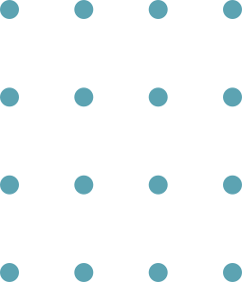
Market Basket Analysis
Market Basket Analysis is a technique used to discover which items are frequently purchased together.
Purpose
Improve product placement
Increase sales through combos
Recommend products
Example
If customers buy:
Bread, they often buy Butter
Mobile, they often buy Earphones

Slide 3

Association Rule Mining Basics
An association rule shows a relationship of the form:
X → Y
Where:
X = antecedent (if part)
Y = consequent (then part)
Key Measures
Support(X → Y) = Probability that X and Y occur together
Indicates frequency.
Confidence(X → Y) = Probability of buying Y when X is bought, Indicates reliability
Lift(X → Y) = Confidence / Support(Y). Measures strength of association

Slide 4
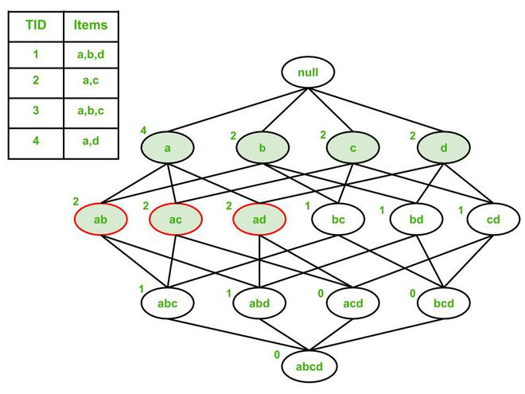
Frequent Itemsets
Frequent itemsets are groups of items that appear together in transactions frequently above a minimum support threshold.
Types
1-itemset (Milk)
2-itemset (Milk, Bread)
3-itemset (Milk, Bread, Butter)
Example
Transactions:
T1: {A, B, C}
T2: {A, B}
T3: {A, C}
T4: {A, B, C}
If min support = 50%
Frequent itemsets:
{A} appears 4 times ✔
{B} appears 3 times ✔
{A,B} appears 3 times ✔
{A,B,C} appears 2 times ✔

Slide 5
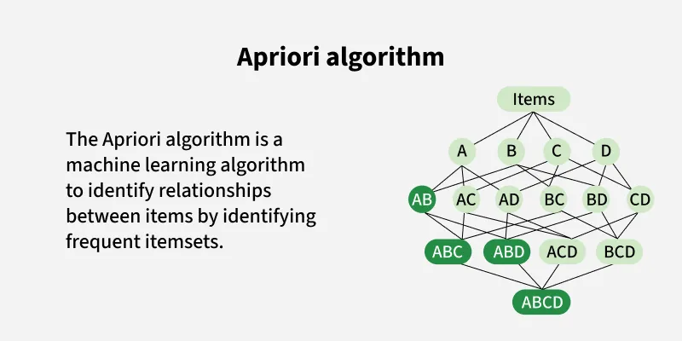
Apriori Algorithm
Apriori is a popular algorithm used to find frequent itemsets and generate association rules.
Steps of Apriori
Find frequent 1-itemsets
Generate candidate 2-itemsets
Remove those below minimum support
Repeat for 3-itemsets, 4-itemsets, etc.
Generate association rules from frequent itemsets
Advantages
Simple and easy
Efficient pruning using Apriori property

Slide 6

Multilevel Association Rules
Multilevel association rules are rules generated at different levels of abstraction using concept hierarchy.
Example hierarchy:
Food
Dairy
Milk
Cheese
Bakery
Bread
Cake
www.reallygreatsite.com

Slide 7
Multidimensional Association Rules
Multidimensional association rules involve more than one attribute/dimension (not just items).
Dimensions can be:
Age group
Location
Gender
Product category
Payment mode
Types of Multidimensional Rules
Inter-Dimension Rules Hybrid-Dimension Rules
Multiple attributes combined: Item + other dimensions:
(Age, City) → Product (Age=20-30, {Milk}) → {Bread}
Importance
Useful in marketing campaigns
Helps in targeted advertising

Slide 8
Correlation Analysis in Data Mining
Zero Correlation
Positive Correlation
Negative Correlation
If X increases, Y increases
Example:
Study hours ↑ → Marks ↑
If X increases, Y decreases
Example:
Screen time ↑ → Sleep time ↓
No relationship
Example:
Shoe size vs IQ

Slide 9

Constraint-based association mining
Constraint-Based Association Mining is the process of generating association rules only when they satisfy specific user-defined constraints.
In large datasets, association rule mining can produce thousands/millions of rules, many of which are not meaningful.
So constraints help to:
reduce number of rules
Improve efficiency
focus on user requirements
reduce computation time
generate business-relevant rules

Slide 10
Thank you
for your attention

